Slide 1
Critical Elements of National Health Security
Ali S. Khan, MD, MPH
Dean and Professor, UNMC College of Public Health
Retired Assistant Surgeon General, USPHS
November 3rd, 2016
Assessing the Threats to Public Health Workshop
Doha, Qatar

Slide 2
Objectives
1. Health Security Threats and Drivers
2. Key Components of U.S. Public Health Security
  And new approaches to health care preparedness
3. Bioterrorism Preparedness and Response
4. Nextgen health security
Notes:
http://www.slideshare.net/GoudaEllabban/hospital-emergency-responseteamstriageforoptimaldisasterresponse
Http://www.academia.edu/4183159/Collaborative_emergency_management_and_national_emergency_management_network
Collaboration: whole community approach – FEMA???

Slide 3
Objectives
Health Security Threats and Drivers
2. Key Components of U.S. Public Health Security
New approaches to health care preparedness
3. Bioterrorism Preparedness and Response
4. Nextgen health security
Notes:
http://www.slideshare.net/GoudaEllabban/hospital-emergency-responseteamstriageforoptimaldisasterresponse
Http://www.academia.edu/4183159/Collaborative_emergency_management_and_national_emergency_management_network
Collaboration: whole community approach – FEMA???

Slide 4


Slide 5
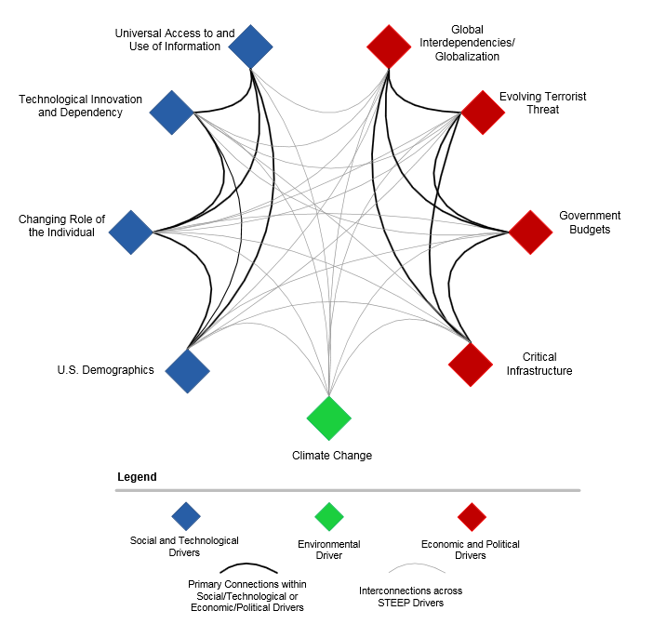
In an age of increasing complexity and uncertainty, there are many forces of change, or “drivers,” reshaping our world.
Source: http://www.fema.gov/media-library-data/20130726-1816-25045-5167/sfi_report_13.jan.2012_final.docx.pdf

Slide 6
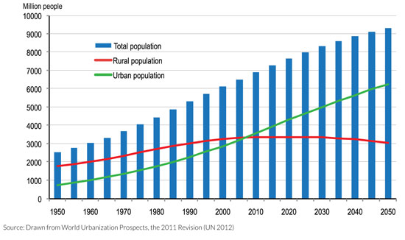
Increased Global Population …
With Urbanization

Slide 7
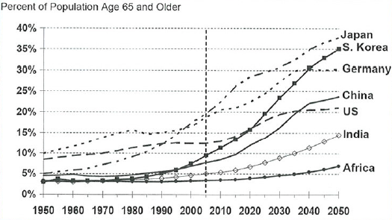
Graying of the Global Population
Relative aging in developing countries begins to increase around 2015
Source: Hayutin A., (NA) Graying of the Global Population Vol. 17, No. 4 Public Policy and Aging Report.

Slide 8
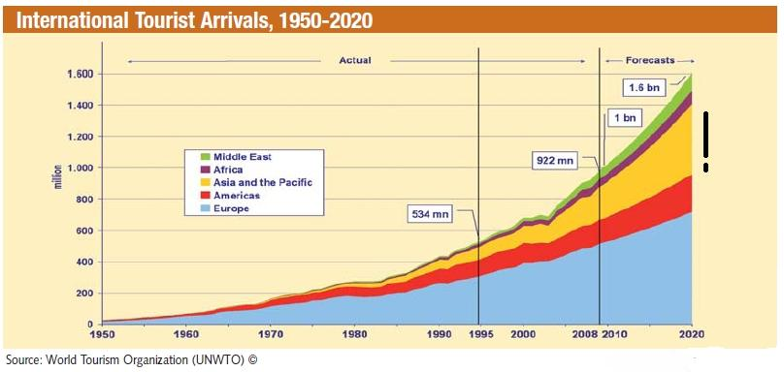
International Travel

Slide 9
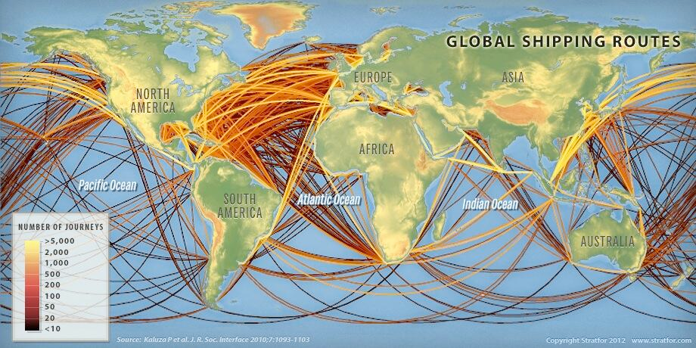
International Trade Routes
Source: http://www.dailymail.co.uk/sciencetech/article-2636152/Watch-worlds-ships-sail-planets-oceans-REAL-TIME-Interactive-map-reveals-crowded-routes-taken-worlds-vessels.html. Retrieved June 23, 2016

Slide 10
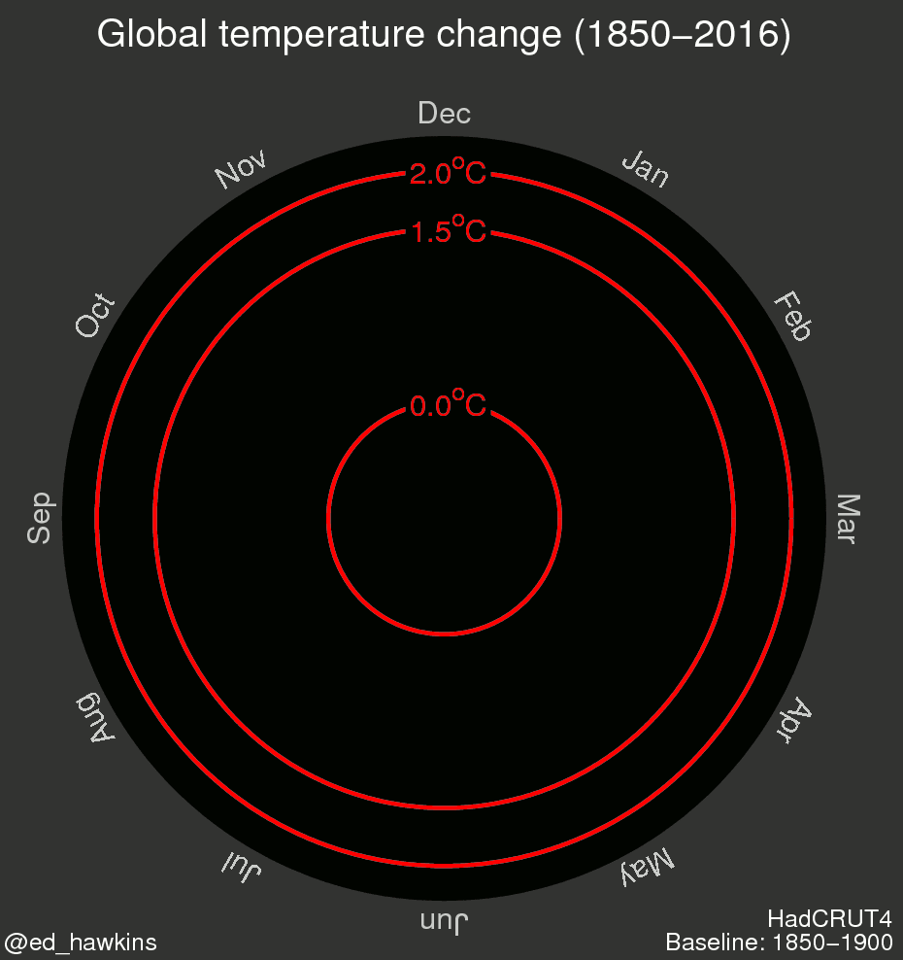
Notes:
10

Slide 11
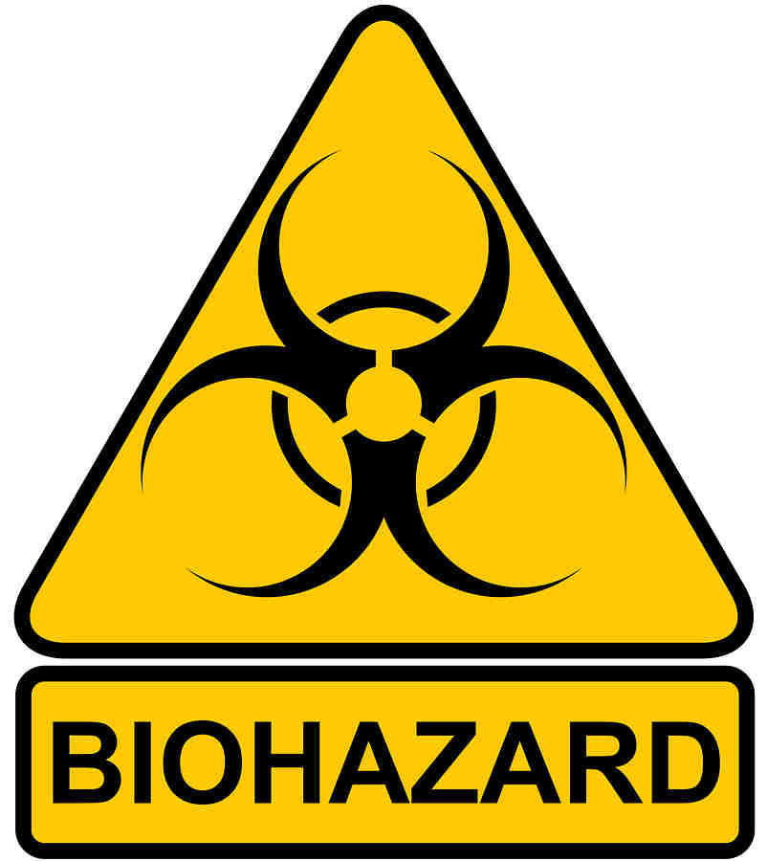
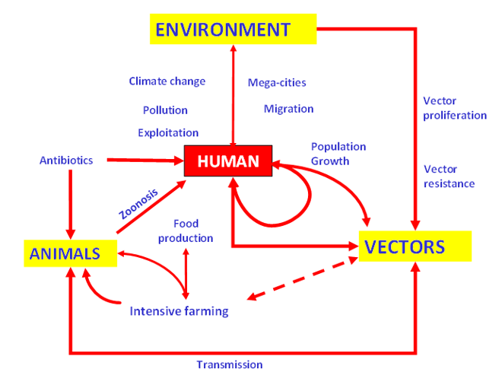
Public Health Risks
Pandemics
Bioterrorism (Biological, Nuclear, Radiological, and Chemical)
Emerging Infections
Natural Disasters
Other Routine Public Health Threats

Slide 12
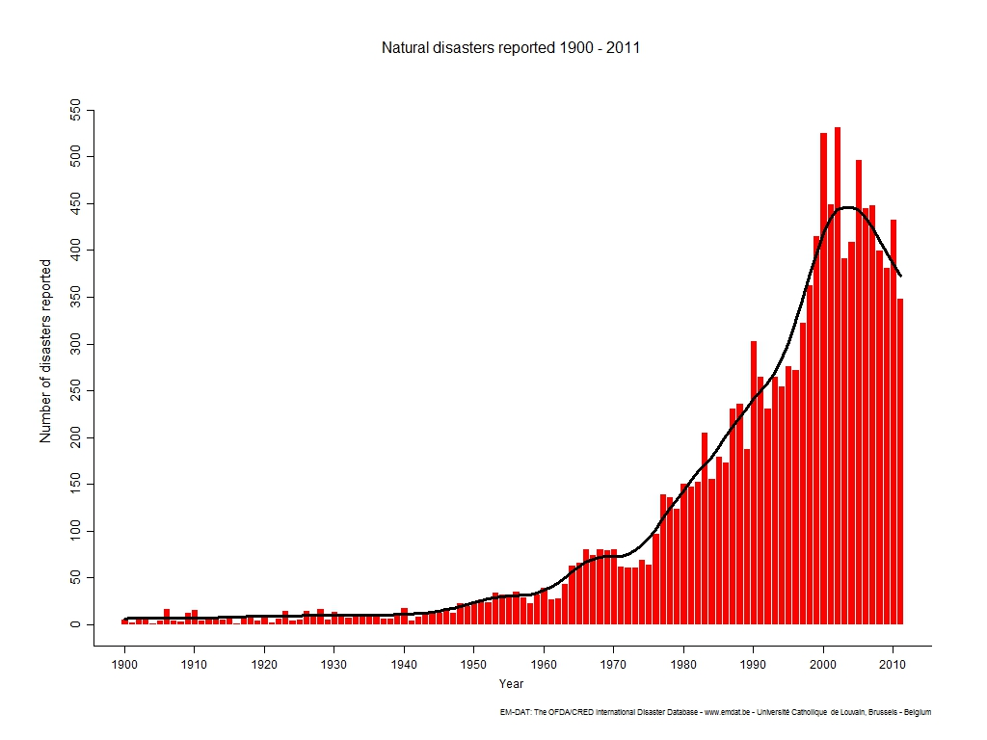
Natural Disasters Reported 1900-2011
Source: www.emdat.be/natural-disasters-trends

Slide 13
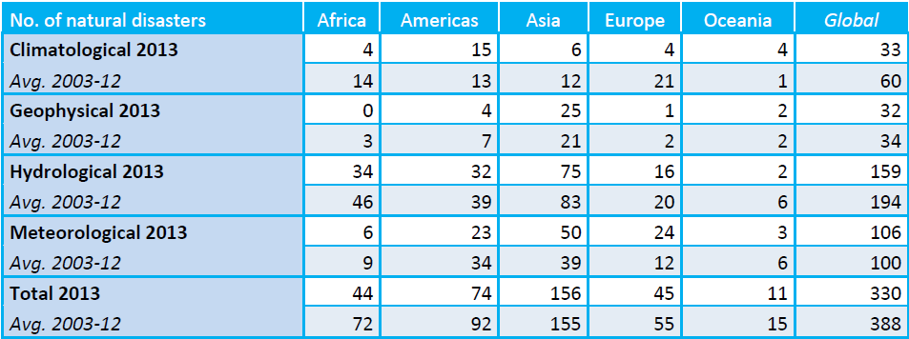
Analysis of Regional Natural Disasters
In 2013, Asia was accounted for 47.3% of all global natural disasters and 90.13% of worldwide reported disaster victims.
Guha- Sapir D., Hoyois P., Below R. (2013) Annual Disaster Statistical Review 2013- The numbers and trends. Centre for Research on the Epidemiology of Disasters (CRED)

Slide 14
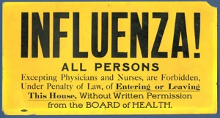

Slide 15

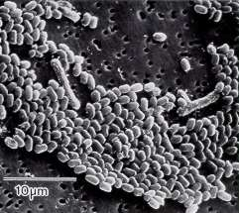
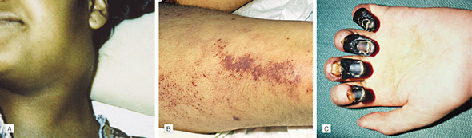
Bioterrorism
Bioterrorism Threats: Priority Biological Agents
Bacterial
  Anthrax
  Plague
  Tularemia
  Glanders/Melioidosis
  Q fever
  Others
    food-borne pathogens
    water-borne pathogens
Anthrax
Plague
The real test is if and when a biological event occurs!
Khan, Ali (2011) “Bioterrorism and Biowarfare”. Epi 562: Emerging Infectious Diseases. Rollins School of Public Health, Emory University

Slide 16
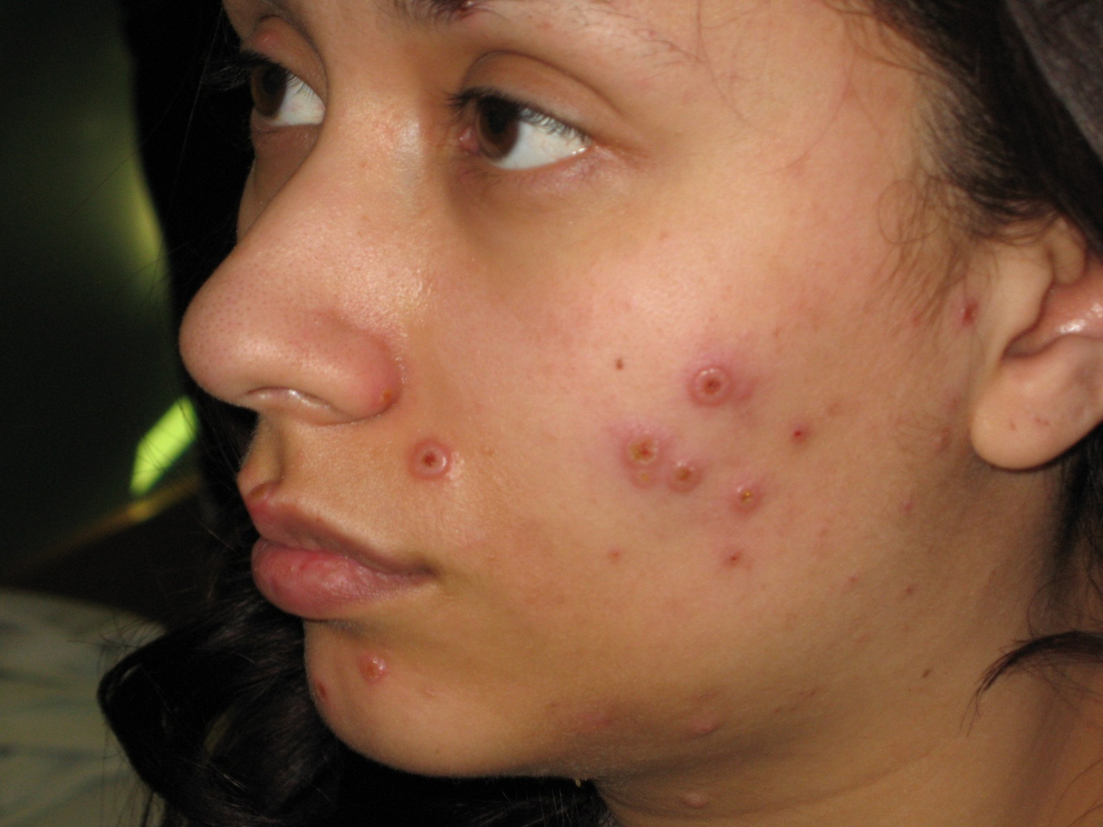


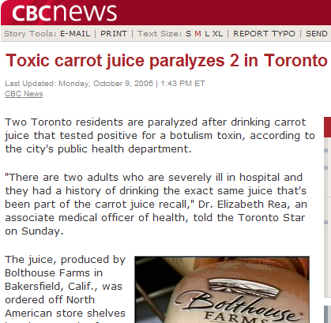

Bioterrorism
  Bioterrorism Threats: Priority Biological Agents
  Viral
    Smallpox
    Viral Hemorrhagic Fevers
    Viral Encephalitis
  Toxins
    Botulism
    Ricin toxin
Smallpox
Foodborne botulism
Khan, Ali (2011) “Bioterrorism and Biowarfare”. Epi 562: Emerging Infectious Diseases. Rollins School of Public Health, Emory University

Slide 17
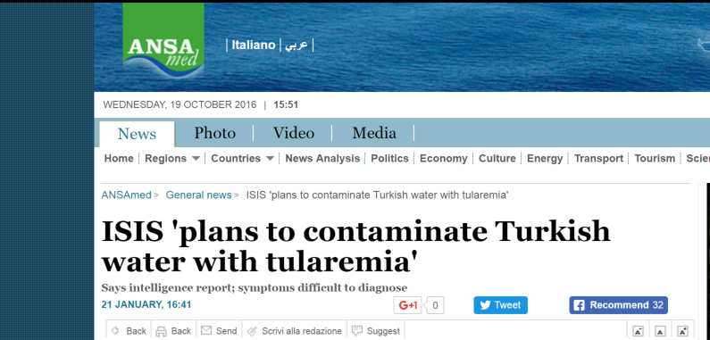


Slide 18
Objectives
1. Health Security Threats and Drivers
2. Key Components of U.S. Public Health Security
  New approaches to health care preparedness
3. Bioterrorism Preparedness and Response
4. Nextgen health security
Notes:
http://www.slideshare.net/GoudaEllabban/hospital-emergency-responseteamstriageforoptimaldisasterresponse
Http://www.academia.edu/4183159/Collaborative_emergency_management_and_national_emergency_management_network
Collaboration: whole community approach – FEMA???

Slide 19


Slide 20
U.S. Doctrine:
The National Preparedness System
National Preparedness Goal
  A secure and resilient nation with the capabilities required across the whole community to prevent, protect against, mitigate, respond to, and recover from the threats and hazards that pose the greatest risk.
National Preparedness System Description
National Preparedness Frameworks
National Planning Scenarios
National Incident Management System
National Preparedness Guide

Slide 21

National Health Security
Critical Component of national security
  Actively works 24/7, securing America from public health threats
Highlighted by 9/11 and reinforced by subsequent events (e.g. anthrax, SARS, H1N1, and Listeria outbreaks)
  2011 had record number of billion dollar natural disasters (12)
Relies heavily on community-wide efforts
  Government alone cannot be responsible for preparedness, response, and recovery

Slide 22
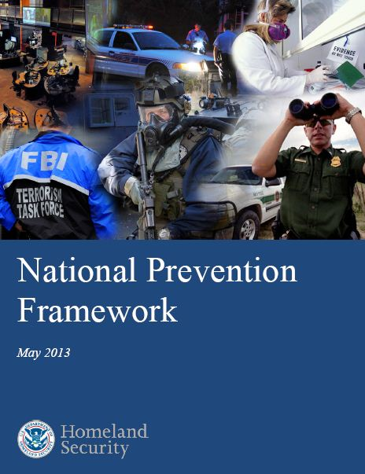

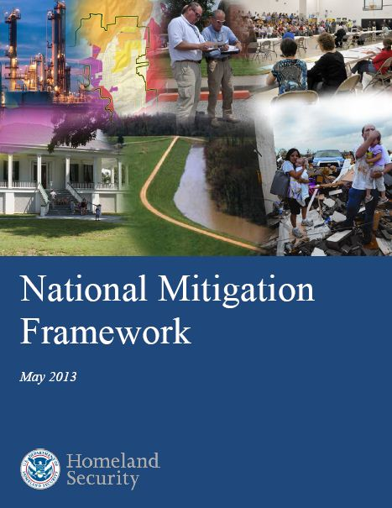

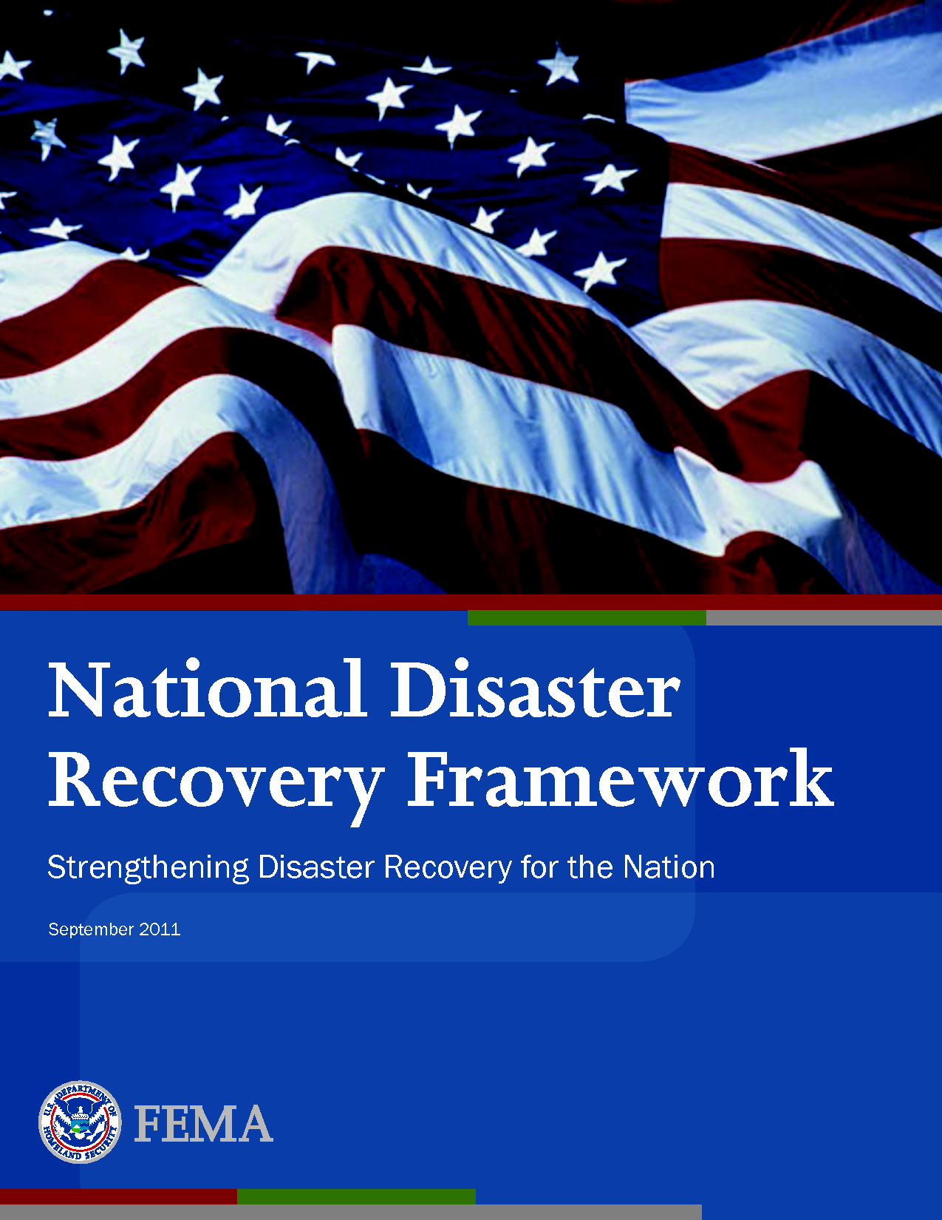
National Preparedness Goal
5 Mission Areas
1. Prevention
2. Protection
3. Mitigation
4. Response
5. Recovery

Slide 23

U.S. National Preparedness
PPD – 8 Core Capabilities
Presidential Policy Directive
PPD – 8:
National
Preparedness
PREVENT
PROTECT
MITIGATE
RESPOND
RECOVER
Planning
Planning
Planning
Planning
Planning
Public Information and Warning
Public Information and Warning
Public Information and Warning
Public Information and Warning
Public Information and Warning
Operational Coordination
Operational Coordination
Operational Coordination
Operational Coordination
Operational Coordination
Community Resilience
Critical Transportation
Economic Recovery
Forensics and Attribution
Access Control and Identity Verification
  National Preparedness
  Goal
  National Preparedness System
  National Preparedness Report
  A Campaign to Build and Sustain Preparedness
Long-Term Vulnerability Reduction
Environmental Response/ Health and Safety
Health and Social Services
Intelligence and Information Sharing
Cybersecurity
Risk and Disaster Resilience Assessment
Housing
Fatality Management Services
Interdiction and Disruption
Intelligence and Information Sharing
Threats and Hazard Identification
Infrastructure Systems
Infrastructure Systems
Mass Care Services
Natural and Cultural Resources
Screening, Search and Detection
Interdiction and Disruption
Physical Protective Measures
Mass Search and Rescue Operations
On-Scene Security and Protection
Risk Management for Protection Programs and Activities
Operational Communications
Screening Search and Detection
Public and Private Services and Resources
Supply Chain Integrity and Security
Public Health and Medical Services
Situational Assessment

Slide 24

Federal Response to Public Health Emergencies
National Response Framework (NRF)
Identifies the roles and responsibilities of 28 federal agencies, including CDC, during federal disaster response operations
State and local governments have primary responsibility for incident response
  Federal assistance provided in accordance with the NRF and the Stafford Act if the event or incident exceeds their capabilities
Source: https://training.fema.gov/hiedu/highref/national%20response%20framework-second%20ed-may%202013-natresp.pdf

Slide 25
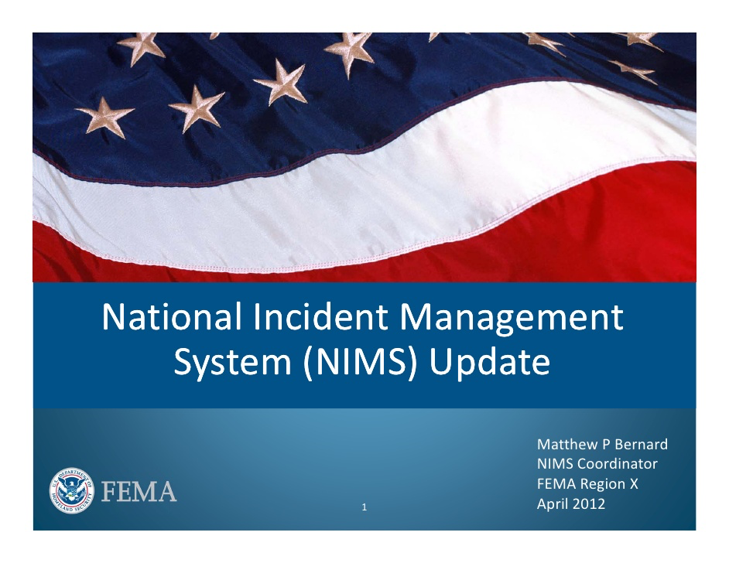
National Incident Management System
What? ... NIMS provides a consistent nationwide template
Who? ... to enable Federal, State, tribal, and local governments, the private sector, and non-governmental organizations to work together
How? ... to prepare for, prevent, respond to, recover from, and mitigate the effects of incidents, regardless of cause, size, location, or complexity
Why? ... in order to reduce the loss of life and property, and harm to the environment
FEMA – Understanding NIMS 700.A. Jan 2012

Slide 26
National Response Framework and CDC’s Role
Department of Homeland Security has overall authority for emergency response activities, as laid out in the National Response Framework (NRF)
Department of Health and Human Services, under the NRF, has responsibility for public health and medical services (Emergency Support Function 8)
Centers for Disease Control and Prevention executes public health response activities
Source: https://training.fema.gov/hiedu/highref/national%20response%20framework-second%20ed-may%202013-natresp.pdf

Slide 27
Public Health
SNS: Strategic National Stockpile
EOC: Emergency Operations Center
State preparedness grants
Medical Countermeasures
DHS: Department of Homeland Security
NIH: National Institute of Health
BARDA: Biomedical Advanced Research and Development Authority

Slide 28
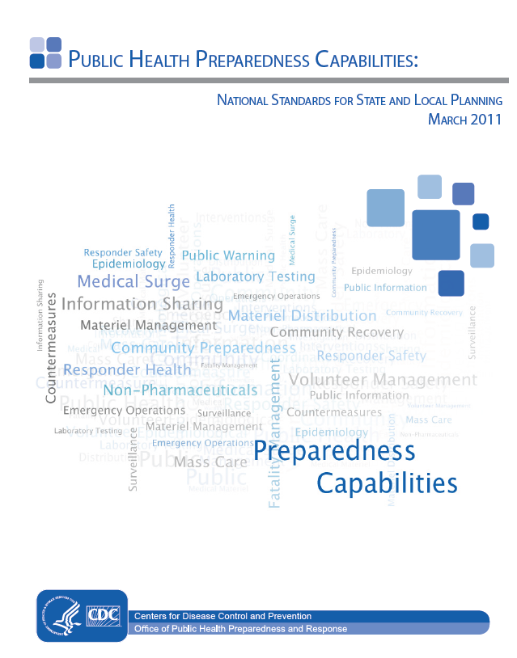
Public Health Preparedness Capabilities:
National Standards for State and
Local Planning
Source: http://www.cdc.gov/phpr/capabilities/DSLR_capabilities_July.pdf

Slide 29
There are 15 Public Health Capabilities:
Community Preparedness
Community Recovery
Emergency Operations Coordination
Emergency Public Information and Warning
Fatality Management
Information Sharing
Mass Care
Medical Countermeasure Dispensing
Medical Material Management and Distribution
Medical Surge
Non-Pharmaceutical Interventions
Public Health Laboratory Testing
Public Health Surveillance and Epidemiology Investigation
Responder Safety and Health
Volunteer Management
Source: http://www.cdc.gov/phpr/capabilities/DSLR_capabilities_July.pdf

Slide 30
Hospital Preparedness Program
Provides leadership and funding to states, territories, and eligible municipalities to improve surge capacity and to enhance community and hospital preparedness for public health emergencies.
  Promote prepared and resilient communities
  Improve infrastructure
  Capability-based approach to planning
  Create coalitions
  Hospital and Public Health are aligned with a cooperative agreement
Source: http://www.phe.gov/preparedness/planning/hpp/pages/default.aspx
Notes:
HPP Program funding supports:
– Improving Infrastructure: Awardees have used HPP Grants to improve the State, local, and territorial infrastructures that help hospitals and healthcare systems prepare for public health emergencies.
– Capability based approach to planning: HPP funding is used to enhance healthcare system planning and response at the State, local, regional and territorial levels.
– Coalitions: Serve as a multi-agency coordinating group that assists Emergency Management and Emergency Support Function (ESF) #8 with preparedness, response, recovery, and mitigation activities related to healthcare organization disaster operations.
demonstrating measurable and sustainable progress toward achieving public health and healthcare emergency preparedness capabilities that promote prepared and resilient communities – hospital and PH aligned cooperative agreement

Slide 31
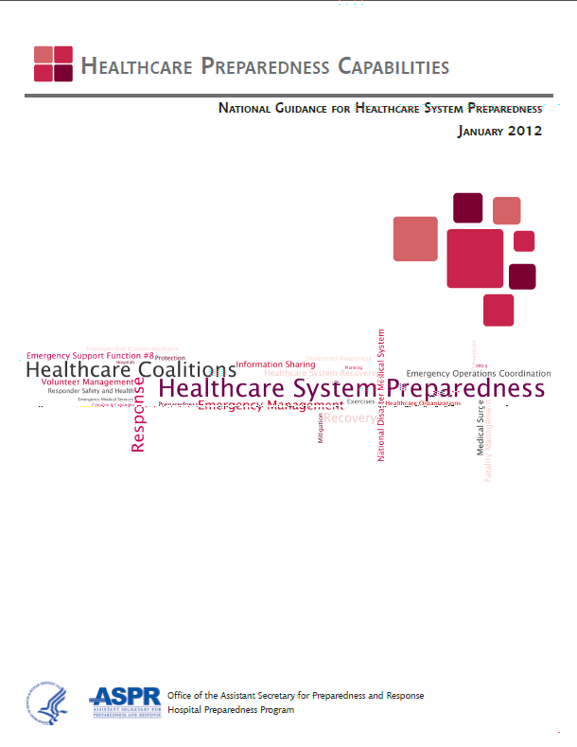
Healthcare Preparedness Capabilities:
National Guidance for Healthcare System
Preparedness
Source: http://www.phe.gov/preparedness/planning/hpp/pages/default.aspx
Notes:
Issues during Sandy and other issues
Expansion from hospital to healthcare, more holistic than before,

Slide 32
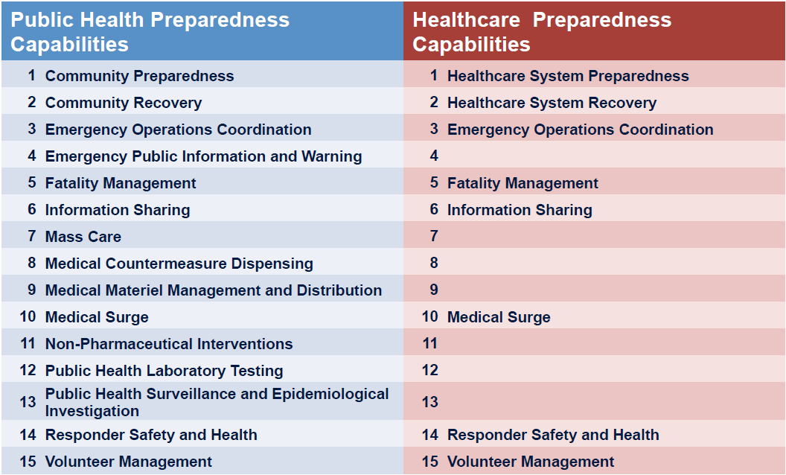
Public Health and Healthcare Preparedness Have Eight Common Capabilities

Slide 33
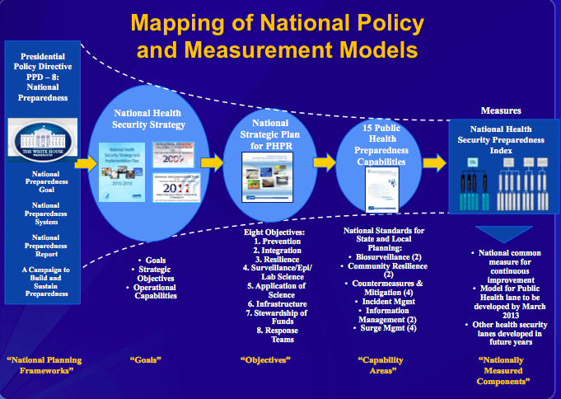

Slide 34

How the U.S Is Doing
The U.S. National Health Security Index
Overall National Preparedness Level: 6.7
3.6% average improvement across all domains since 2013
Preparedness by Domain
  Health Security Surveillance: 7.5
  Community Planning & Engagement: 5.4
  Incident & Information Management: 8.4
  Healthcare Delivery: 5.1
  Countermeasure Management: 7.0
  Environmental & Occupational Health- 6.4
Scored best
Scored worst
Source: http://nhspi.org/

Slide 35
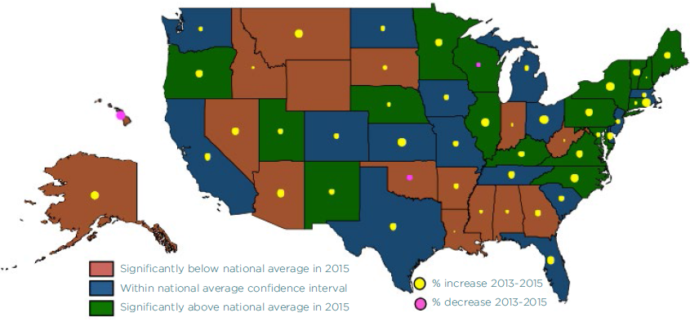
U.S National Health Security Preparedness by State
Source: NHSPI Executive Summary 2016 http://nhspi.org/

Slide 36
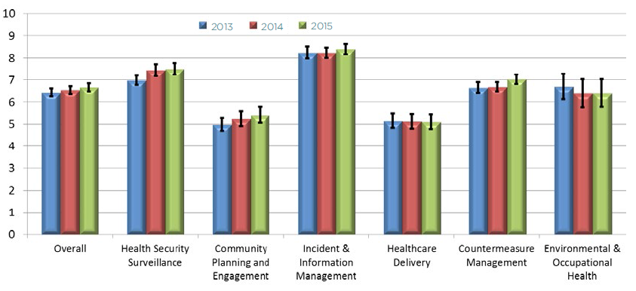
U.S. National Preparedness Trend, 2013-2015
Source: NHSPI Executive Summary 2016 http://nhspi.org/
Notes:
National preparedness trended upward in most functional areas during 2013-15, except in environmental health
and in healthcare delivery.

Slide 37
Objectives
Health Security Threats and Drivers
2. Key Components of U.S. Public Health Security
  New approaches to health care preparedness
3. Bioterrorism Preparedness and Response
4. Nextgen health security
Notes:
http://www.slideshare.net/GoudaEllabban/hospital-emergency-responseteamstriageforoptimaldisasterresponse
Http://www.academia.edu/4183159/Collaborative_emergency_management_and_national_emergency_management_network
Collaboration: whole community approach – FEMA???

Slide 38
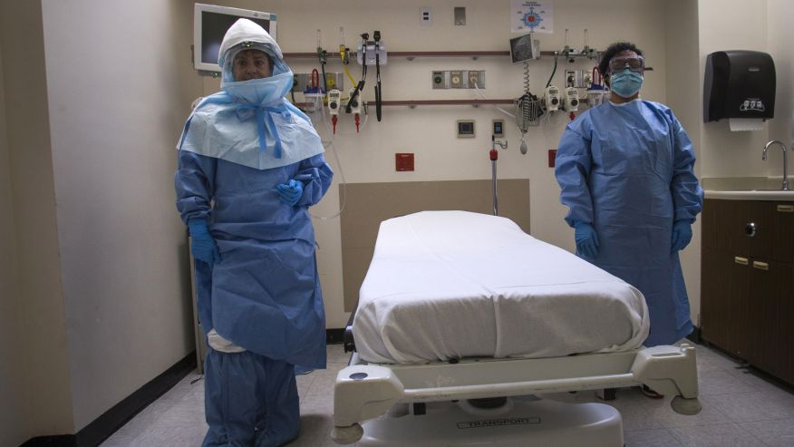
New “Old Paradigm”

Slide 39
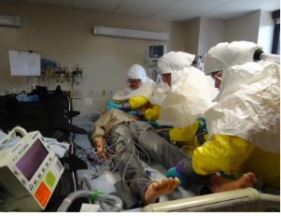
Nebraska Biocontainment Unit
Opened in 2005 to care for patients with highly contagious infectious diseases
Negative air pressure in the entire unit
2 pass-through autoclaves
All volunteer staff
  Extensive interview process
  On-call 24 hours/day
Training and maintenance of skills
  Monthly staff meetings
  Quarterly drills
  Internal and external partners

Slide 40
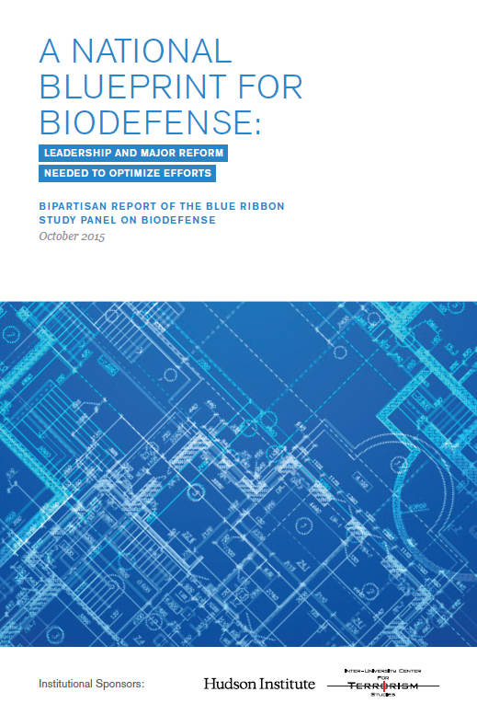
Healthcare Response to High-Hazard Pathogens
Blue Ribbon Panel on Biodefense created 33 recommendations for biodefense preparedness in the United States
http://www.biodefensestudy.org/

Slide 41
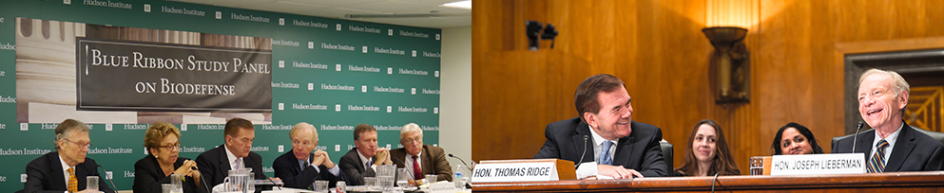
Hospital Biodefense
Recommendation 21: Establish a biodefense hospital system
Stratify hospitals
  Increase levels of capacity to treat patients affected by bioterrorism and highly pathogenic infectious diseases
Accreditation standards for each stratum
  Accreditation standards, certifications, and licensure associated with each level
Centers for Medicare and Medicaid Services (CMS) funding
  Associate funding with hospital’s ability to meet accreditation standards

Slide 42

Other Recommendations from the National Blueprint for Biodefense
Recommendation 18: Establish and utilize a standard process to develop and issue clinical infection control guidance for biological events.
Standardize the development of clinical infection control guidelines before biological events occur.
Institute a process for obtaining and incorporating feedback regarding clinical infection control guidelines during biological events.
Require training based on these guidelines.

Slide 43
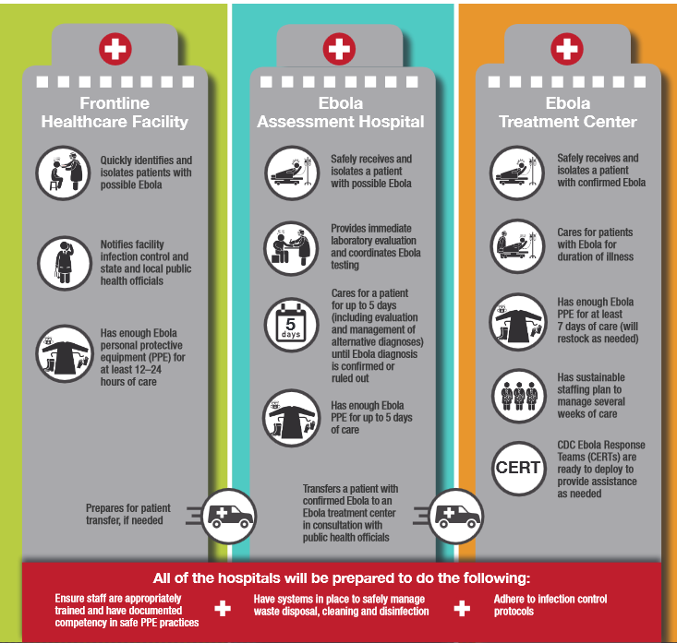

Slide 44
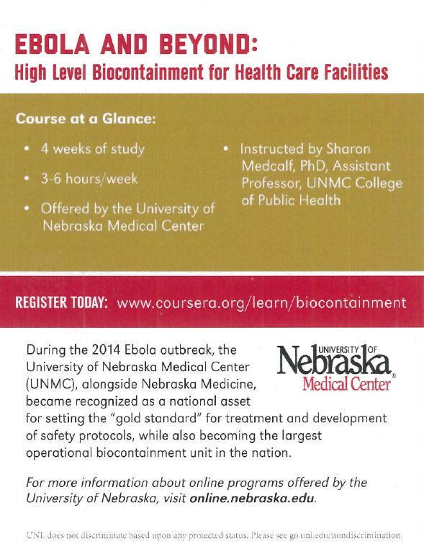


Ebola Online Training

Slide 45
Objectives
1. Health Security Threats and Drivers
2. Key Components of U.S. Public Health Security
  New approaches to health care preparedness
3. Bioterrorism Preparedness and Response
4. Nextgen health security
Notes:
http://www.slideshare.net/GoudaEllabban/hospital-emergency-responseteamstriageforoptimaldisasterresponse
Http://www.academia.edu/4183159/Collaborative_emergency_management_and_national_emergency_management_network
Collaboration: whole community approach – FEMA???

Slide 46
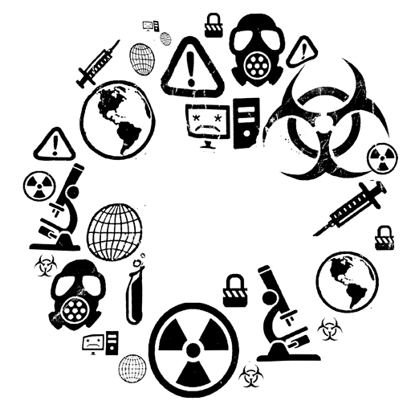
http://www.nationaldefensemagazine.org/archive/2012/November/Pages/TopFiveThreatstoNationalSecurityintheComingDecade.aspx

Slide 47
(N = 435)*
Cases of Human Anthrax in U.S., 1951–2006
Animal (Stern) vaccination started in 1957, after OK enzootic. Recommended for use in animals in endemic areas thereafter
70
Animal (Stern) vaccination started in 1957, after OK enzootic. Recommended for use in animals in endemic areas thereafter
60
2001 anthrax letter attacks
2001 anthrax letter attacks
50
40
Number Cases
30
20
10
0
1951
1955
1959
1963
1967
1971
1975
1979
1983
1987
1991
1995
1999
2003
Year
*Only 30 of these cases were inhalation; the remainder were cutaneous.
^{W}One case (inhalation anthrax) reported to date, 2006

Slide 48
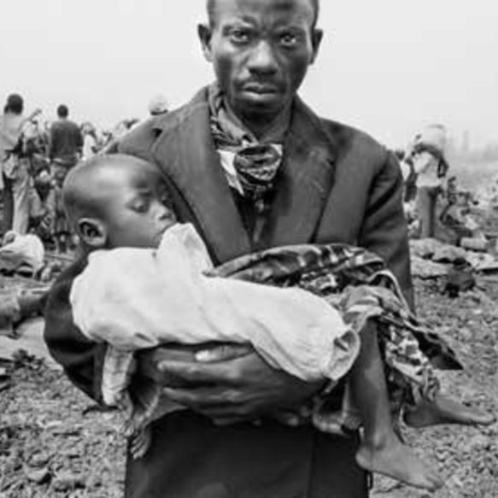
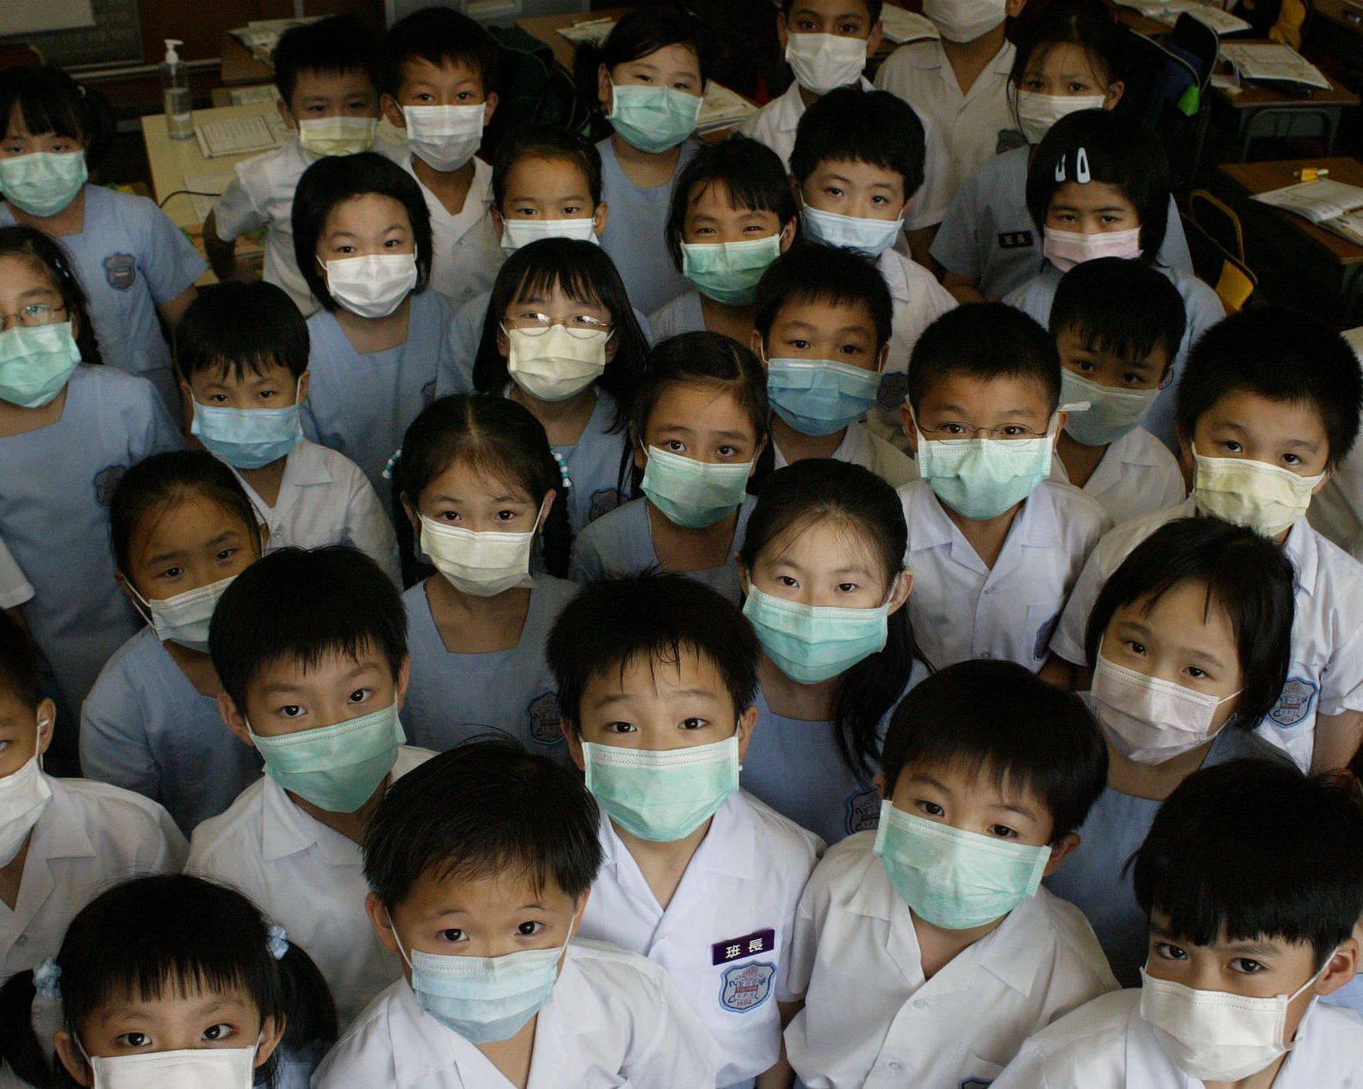
Epidemiological Clues of Bioterrorism
We look for …
  Large outbreak with high illness and death rate
  Single case of uncommon disease (e.g. smallpox)
  Unusual symptoms or severity of illness
  Infection is non-endemic to region
  Unusual seasonal distribution
  Multiple simultaneous outbreaks in non-contiguous areas
  Sick or dying animals

Slide 49
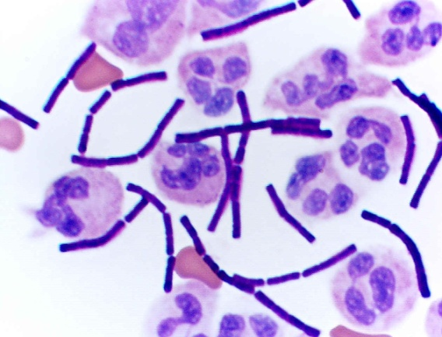
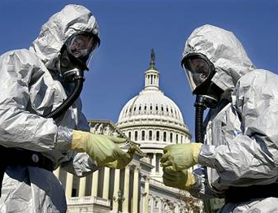

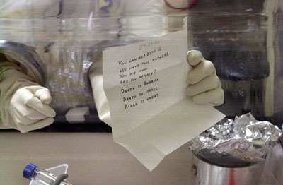
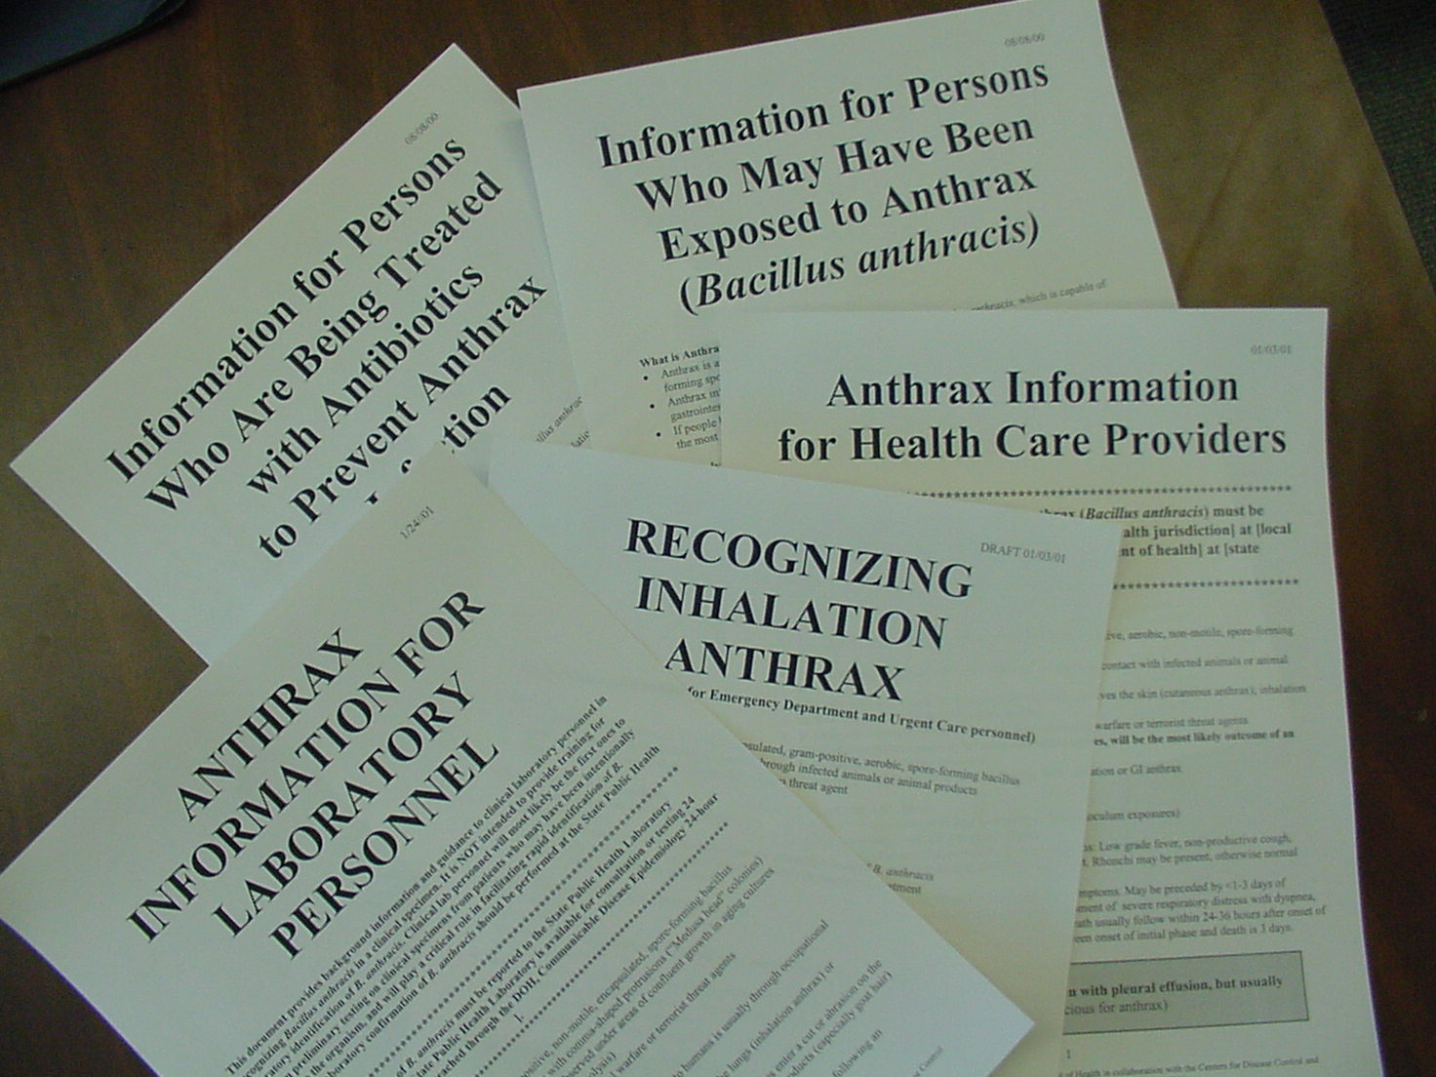

Slide 50
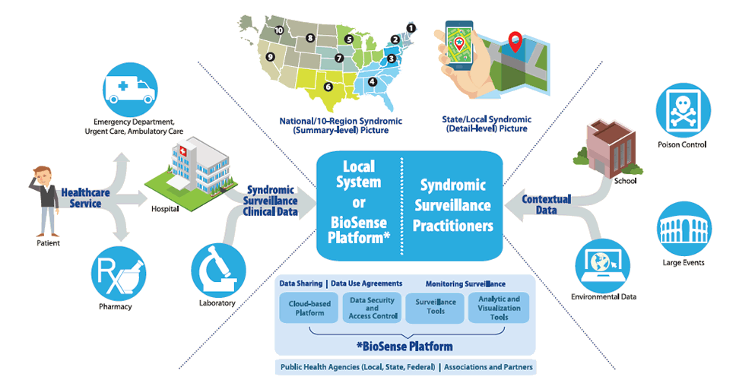
Public Health Response to Bioterrorism
  Surveillance
    Syndromic Surveillance uses syndromic data and statistical tools to detect, monitor, and characterize unusual activity for further public health investigation or response
    National Syndromic Surveillance Program (NSSP)
    Biosense Platform, a Collaborative Community of Practice
Syndromic Surveillance Data Flow
CDC (March, 2016) National Syndromic Surveillance Program (NSSP). Retrieved on Oct. 5th, 2016 from http://www.cdc.gov/nssp/overview.html
Notes:
Surveillance- a collaboration between different public health agencies to exchange syndromic data to improve situational awareness and responsiveness to hazardous events and disease outbreaks.
Biosense- since 2011 Biosense focused on the expansion of situational awareness for all-hazards preparedness and response. Personnel use cloud-based platform and a secure integrated electronic health information system with standardized analytic tools to improve common awareness of health threats over time and across regional boundaries.
Collaborative Community of Practice comprises of participants collaborate to advance the science and practice of syndromic surveillance

Slide 51

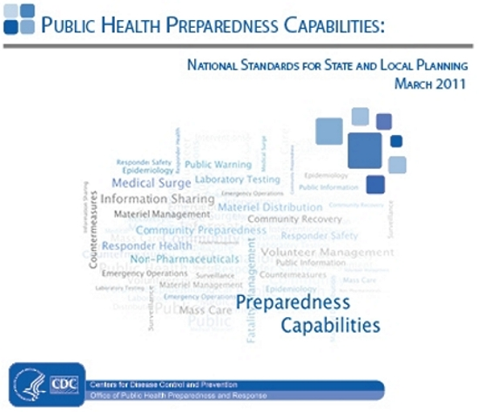
Public Health Response to Bioterrorism (cont.)
  Laboratory Response Network
  Federal Select Agent Program
    Regulate and oversee laboratories that work with biological agents and toxins which have the potential to pose severe threats
  National Standards for Public Health Preparedness

Slide 52
Laboratory Response Network in U.S.
National network of local, state, and national laboratories doing public health, food, animal diagnostic, and environmental testing
Together provides the laboratory infrastructure and capacity to respond to both biological threats and chemical terrorism (and other public health emergencies, too)
Over 150 laboratories, each affiliated with
  federal government agency
  military installation
  international partner
  state or local community public health department
Source: CDC The Laboratory Response Network Partners in Preparedness. Retrieved on 13 Sept 2016 from https://emergency.cdc.gov/lrn/index.asp

Slide 53
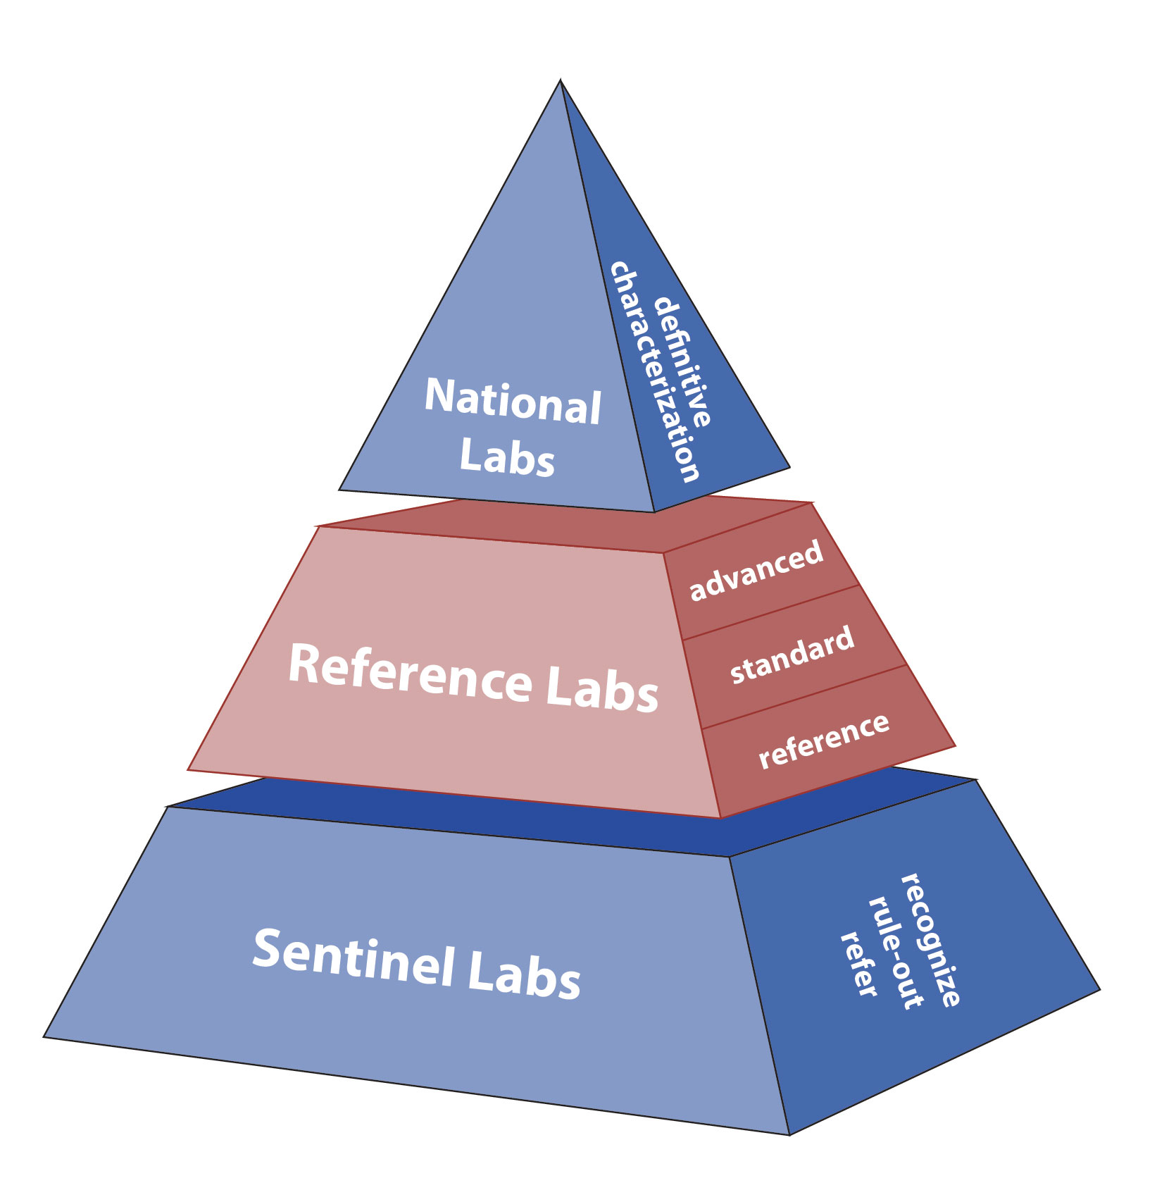
LRN Structure for Biological Threats
National Labs – unique resources to handle highly infectious agents and ability to identify specific agent strains
Reference Labs – can detect and confirm threat agents, ensuring timely local response in the event of a threat. Many reference labs can produce conclusive results – allowing local authorities to respond quickly – rather than relying on confirmation from a centralized lab (e.g. CDC)
Sentinel Labs – e.g. thousands of hospital-based labs – have direct contact with patients and could be the first facility to spot a suspicious specimen. Sentinel Labs are responsible for referring a suspicious sample to the correct reference lab.
Sources: https://emergency.cdc.gov/lrn/factsheet.asp;
https://www.aphl.org/aboutAPHL/publications/Documents/PHPR_Data_Exchange_Brief_62016.pdf

Slide 54
Objectives
1. Health Security Threats and Drivers
2. Key Components of U.S. Public Health Security
  New approaches to health care preparedness
3. Bioterrorism Preparedness and Response
4. Nextgen health security
Notes:
http://www.slideshare.net/GoudaEllabban/hospital-emergency-responseteamstriageforoptimaldisasterresponse
Http://www.academia.edu/4183159/Collaborative_emergency_management_and_national_emergency_management_network
Collaboration: whole community approach – FEMA???

Slide 55

Weaknesses in our global health security system highlight the need for restructuring, nationally and globally

Slide 56

Summary: Blueprint for Biodefense
Leadership Reform
The challenge of leadership
  Require centralized leadership to control, prioritize, coordinate, and hold agencies accountable toward common national biodefense
The challenge to achieve coordination and accountability
  Require a comprehensive biodefense strategy and a unified approach to budgeting
The need for leadership to elevate coordination
  U.S. biodefense is not solely a federal function. Increase coordination requires strengthening state, local, territorial, and trial biodefense capabilities
The need for leadership to drive innovation
  Increase focus on innovation because biological threats are imminent and complex
http://www.biodefensestudy.org/

Slide 57
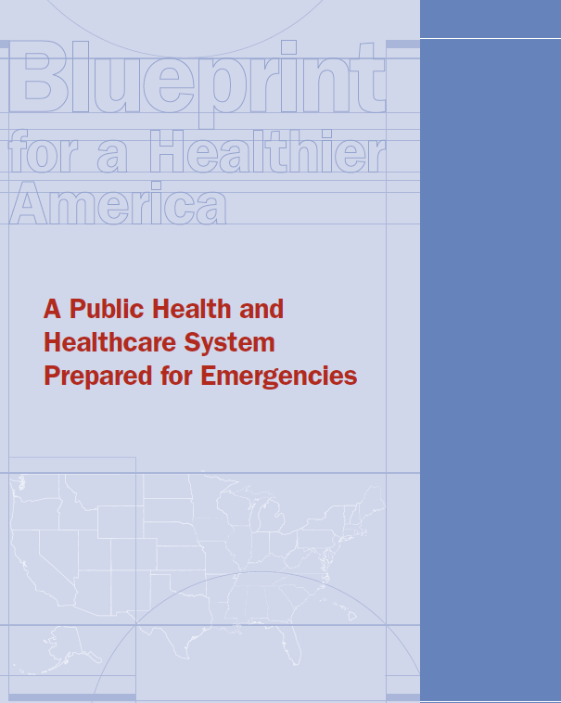
Trust for America’s Health
A public health and healthcare system that is prepared for emergencies
  Reform baseline abilities to diagnose, detect, and control health crises
  Stable, sufficient funding for ongoing emergency preparedness
  Improve federal leadership before, during, and after disasters
  Support scientific and technological upgrades (faster diagnostics, biosurveillance, countermeasures)
  Modernize real-time, interoperable disease surveillance
  Support medical countermeasure research, development, stockpiling and distribution
  Maintain a robust, well-trained public health workforce
  Develop new strategy for hospital and healthcare emergency preparedness
  Support community resilience
Source: Blueprint for a Heathier America 2016. Trust for America’s Health
http://healthyamericans.org/reports/

Slide 58
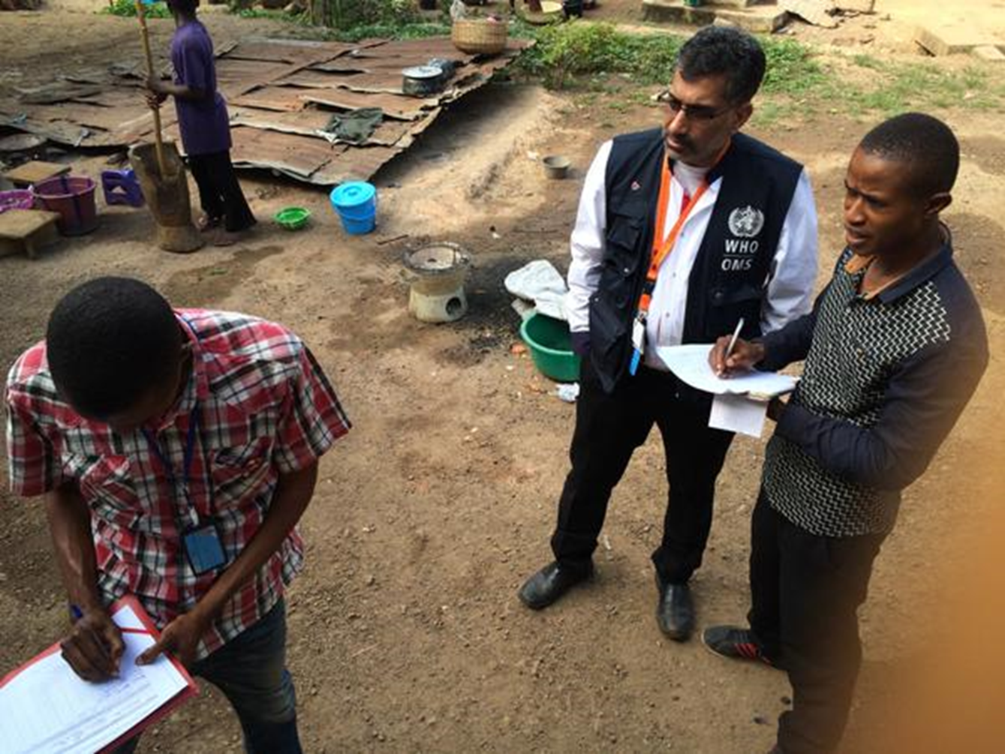
Ebola:
Observation and Field Response

Slide 59


Slide 60
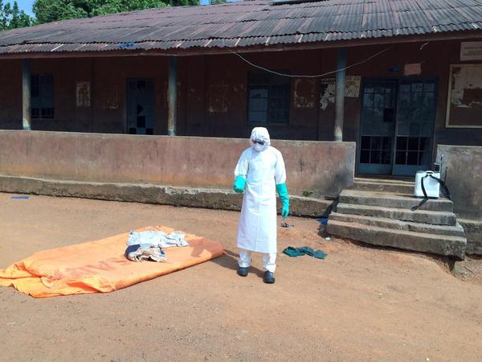
Ali S Khan- College of Public Health University of Nebraska Medical Center

Slide 61
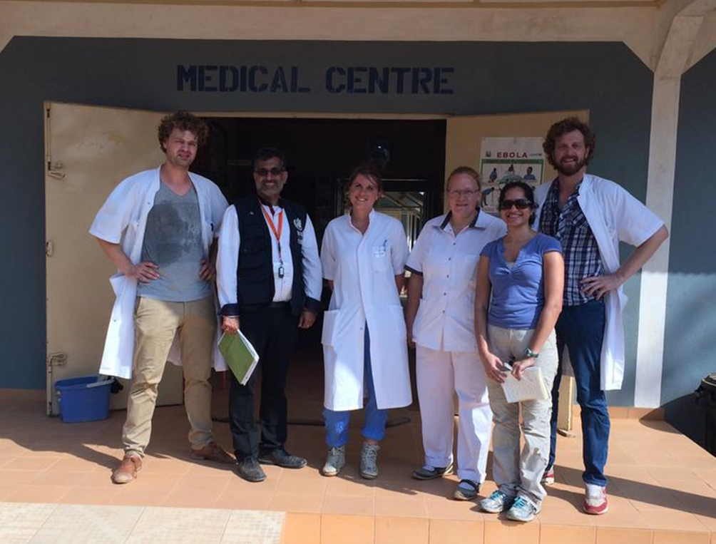

Slide 62
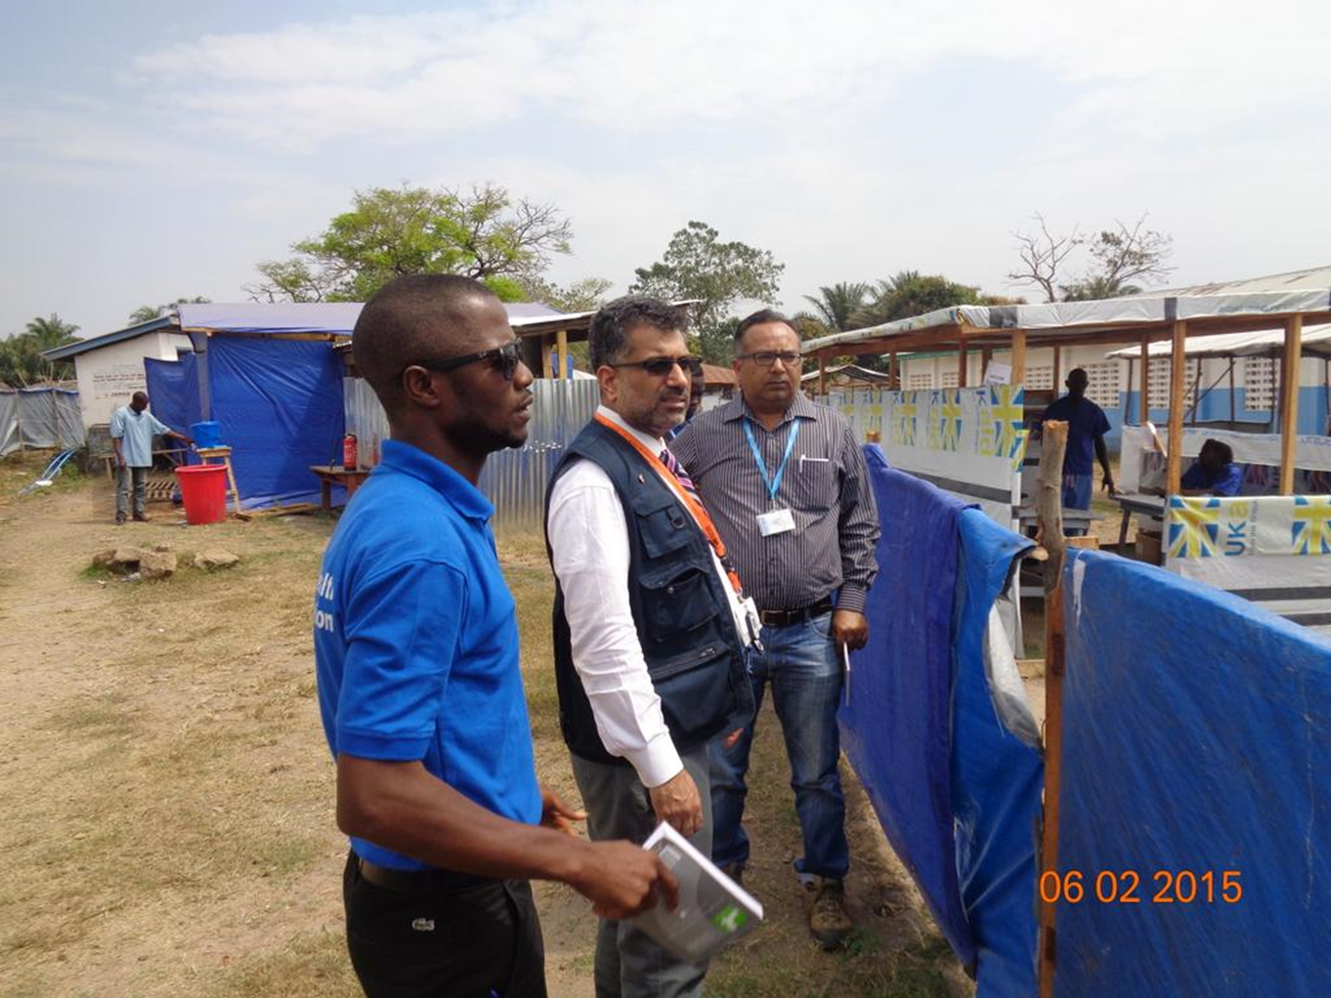

Slide 63
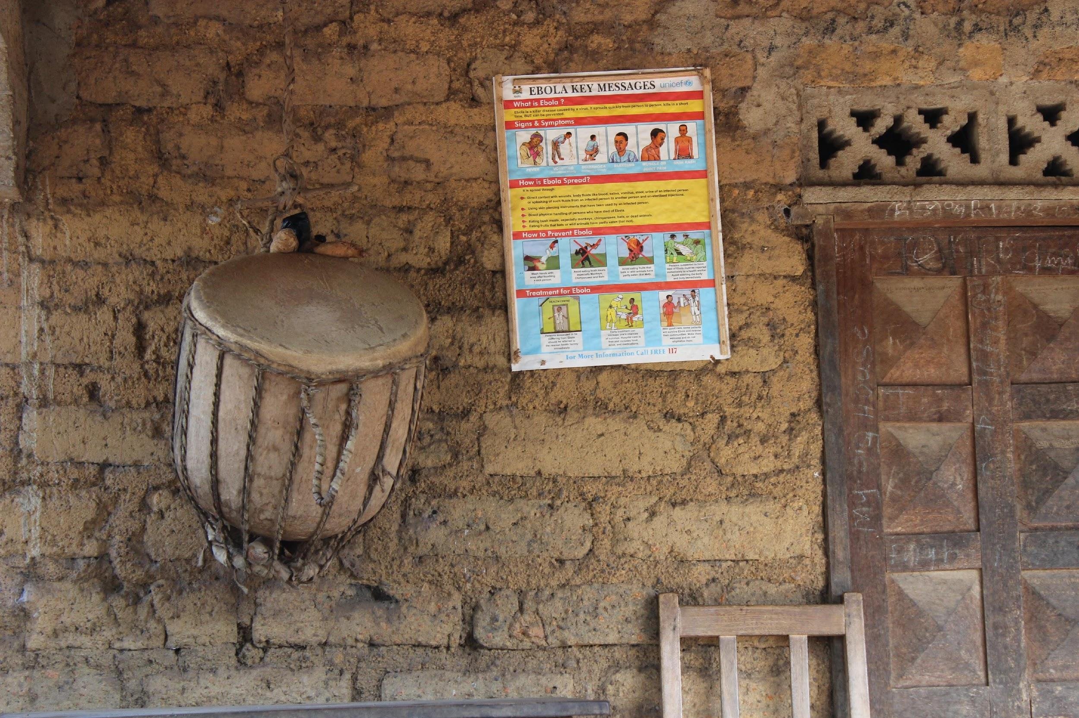
Ali S Khan- College of Public Health University of Nebraska Medical Center

Slide 64

Global Health Security Agenda (GHSA)
Multilateral and multi-sectoral approach to:
strengthen overall global capacity and each nation’s capacity
to prevent, detect, and respond to infectious disease threats – both human and animal
threats occurring naturally or being spread accidentally or deliberately
• Facilitates collaborative, capacity-building efforts toward specific, measurable targets around biological threats
Accelerates meeting the core capacities required by:
  WHO International Health Regulations (IHR)
  World Organization of Animal Health's (OIE) Performance of Veterinary Services Pathway
  other relevant global health security frameworks
Source: https://ghsagenda.org

Slide 65
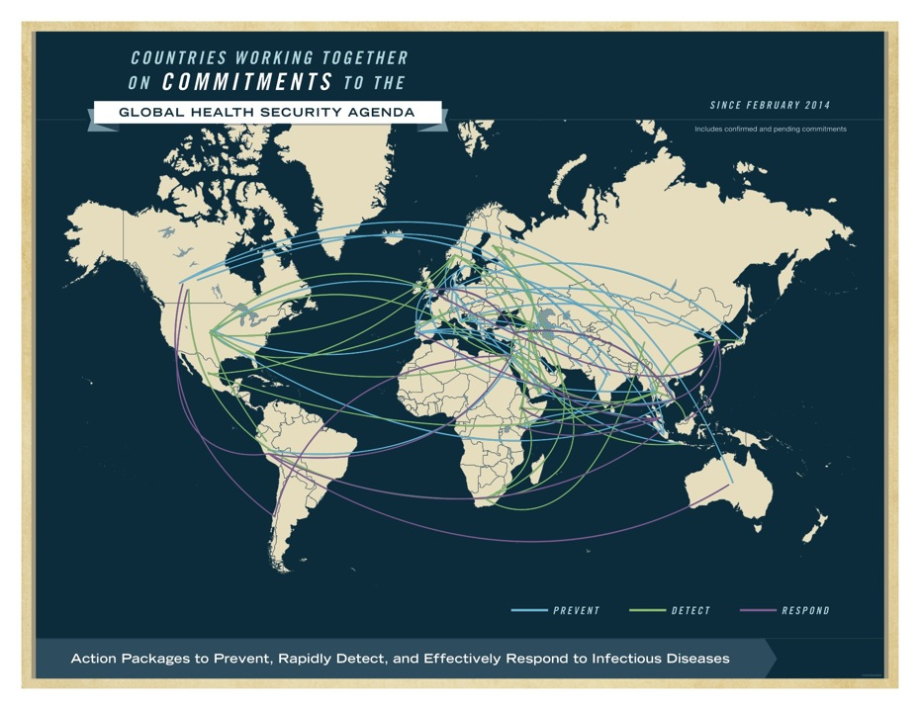
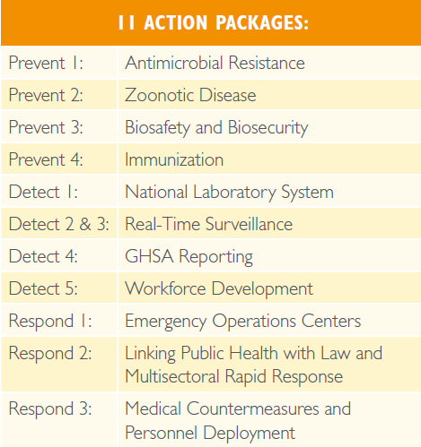
Action Package Targets
The 11 GHSA Action Packages cover 3 areas of action
  Prevent Avoidable Epidemics
  Detect Threats Early
  Respond Rapidly and Effectively
Five-Year Target for each country:
  -- Real-time biosurveillance
  -- A national laboratory system
  -- Effective modern point-of-care and laboratory-based diagnostics

Slide 66

When it comes to
global health, there is no “them”... only “us.”
– Global Health Council

Slide 67
Acknowledgements
    Trang K. Hoang, BS, MPH-Candidate
    Matthew Bosley, MD, FAAP, MPH-Candidate

